Slide 1
SAMPLE PREPARATION USING POWDER CANS
HB2a Instrument Team
High Flux Isotope Reactor
July 2016

Slide 2
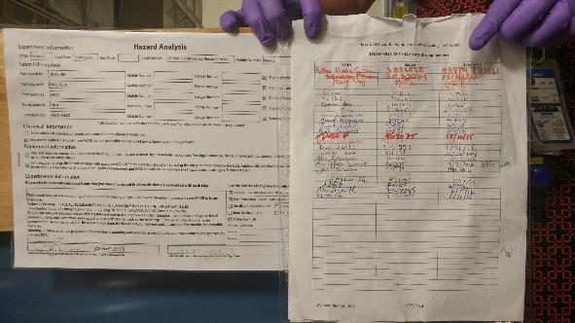
[ PREPARING THE CAN]
1. Read and sign the JHA to use the cryolab sample prep table.

Slide 3
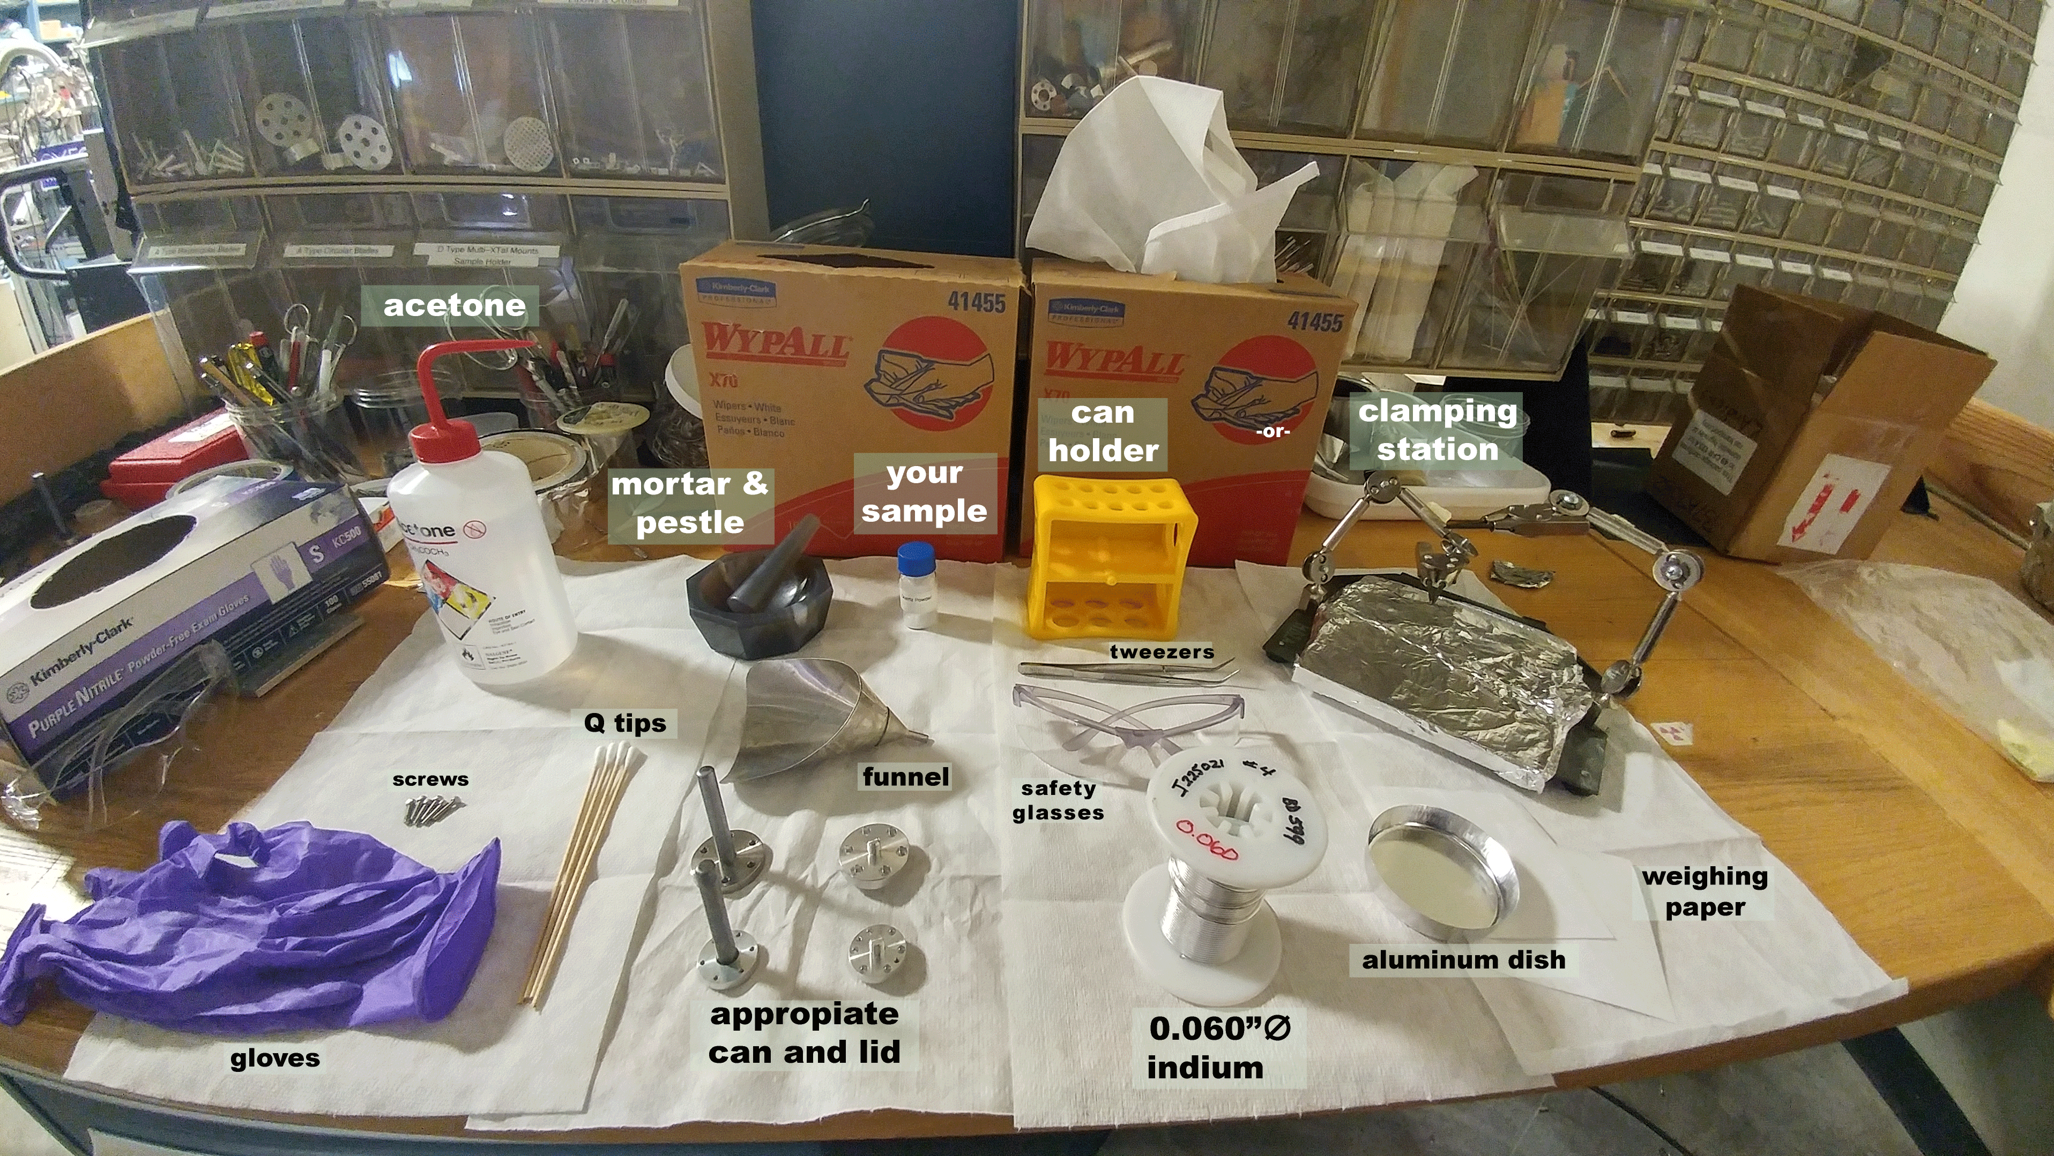
Here are the materials you will need for preparing the sample can.

Slide 4
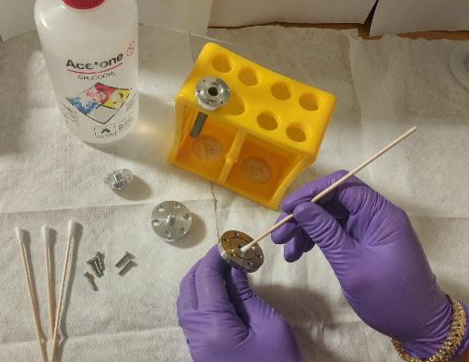
2. Using acetone and a Q-tip, clean the interior and exterior of the can and lid.

Slide 5
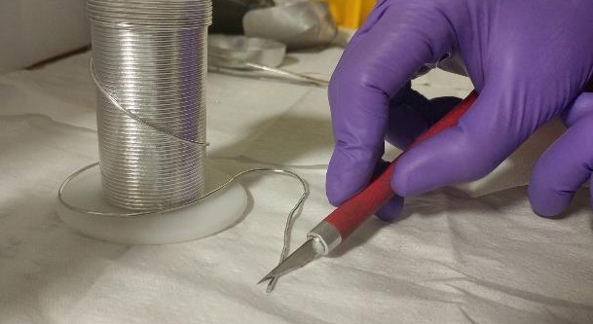
3. Preparing the indium gasket:
Using a knife, cut the tip of the indium.
Indium is 0.060” diameter

Slide 6
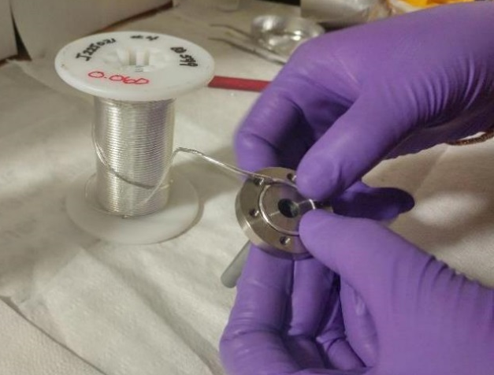
3. Preparing the indium gasket:
b) Carefully insert the indium into the groove without making marks on the soft indium.

Slide 7
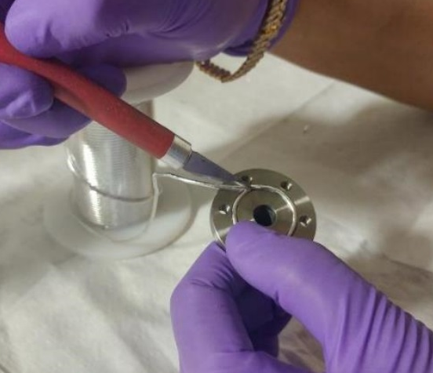
3. Preparing the indium gasket
Using the wooden end of a Q-tip, press lightly on the intersection to push the indium into the groove. Be careful not to break the indium.
Use the knife to cut out the extra length
Ti-flange on V cans
Al-lids for V cans
Aluminum and Copper Cans
c) Cut the indium such that both ends overlap to complete the loop, with some extra indium (see sketch above for the can or lid you are using).

Slide 8
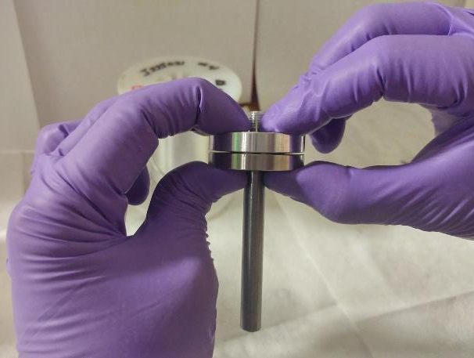
4. Place the lid over the flange and press over to squeeze the indium over the groove.

Slide 9
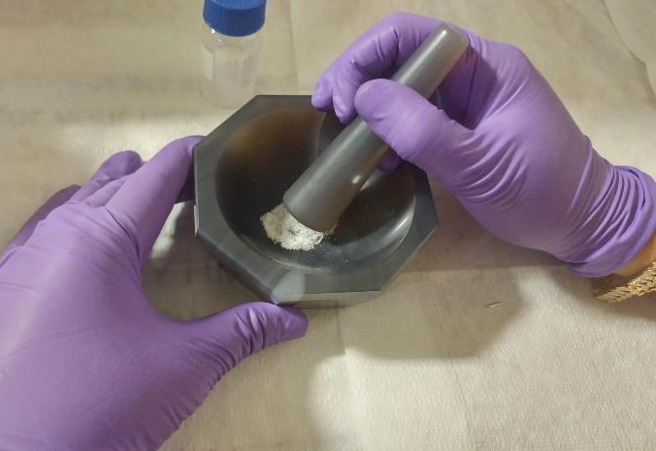

[ PREPARING THE SAMPLE]
1. Use the agate mortar and pestle to grind samples.
WARNING: Ensure that the sample has been cleared by the instrument team and ES&H for grinding.

Slide 10
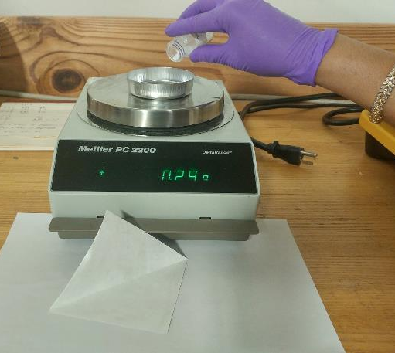
2. Using weighing paper and/or an aluminum dish, weigh the sample for your records.

Slide 11
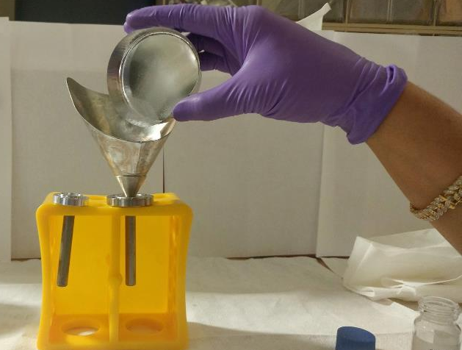
3. Put the sample into a can using one of two options:
a) Using a funnel and holder to funnel sample into the can, or…

Slide 12
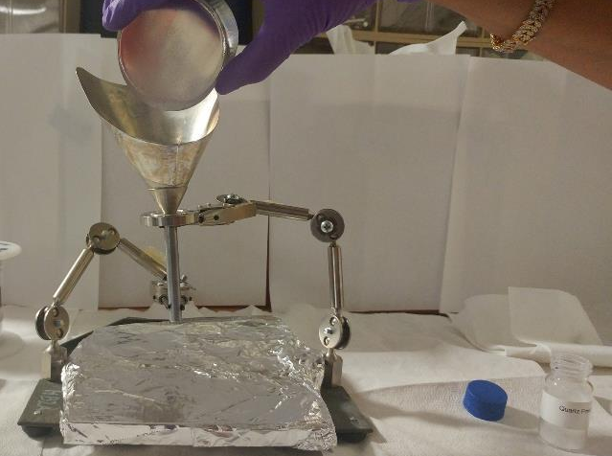
3. Put the sample into a can using one of two options:
b) Use the clamping station

Slide 13
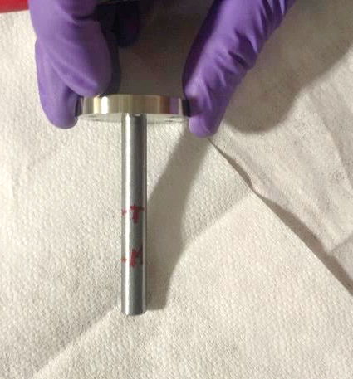
4. Visually determine the top level of your sample in the can. Using a permanent marker, make marks on the outside of the can indicating the top and midpoint of sample. This helps align the sample with the beam center.
Top of sample
Middle point of sample, this will be aligned with beam center

Slide 14
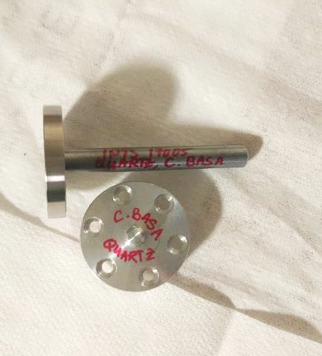
Write sample information on the side of the can and on top of the lid.

Slide 15
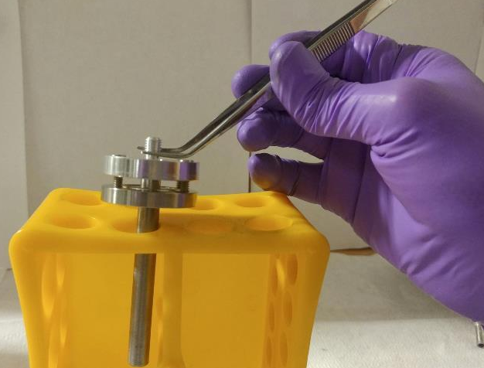
5. Place lid over flange and secure all the 6 screws halfway through. Make sure you are able to lift the lid with the can attached.
Ti Flange Vanadium Cans (High Temp cans)-> 6-32 screws
Al Flange Vanadium cans (Low Temp cans)-> 2-56 screws

Slide 16
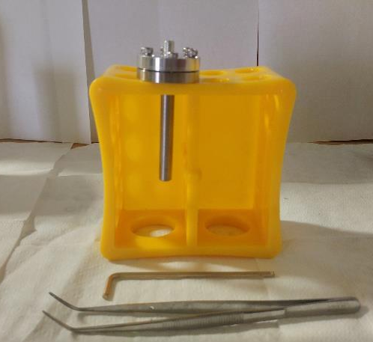
[ SEALING A CAN WITH HELIUM GAS USING THE GLOVEBOX]
1. Take sample can in holder and the corresponding Allen wrench.

Slide 17
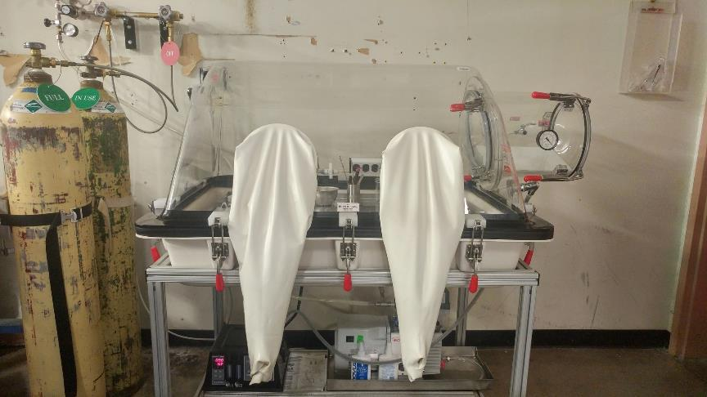

2. Take to the cryolab Helium glovebox.
WARNING: Do not proceed if oxygen sensor below the glovebox is alarming.

Slide 18
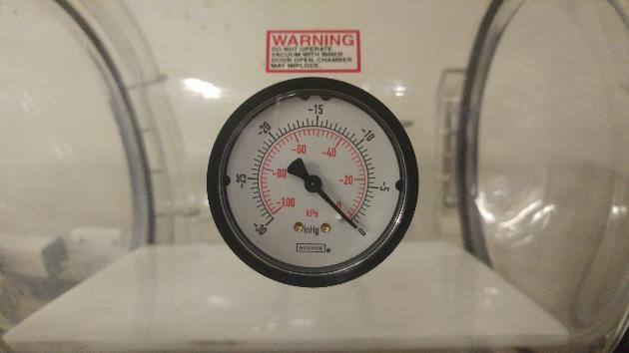
3. Ensure the pressure gauge reads zero before proceeding.

Slide 19
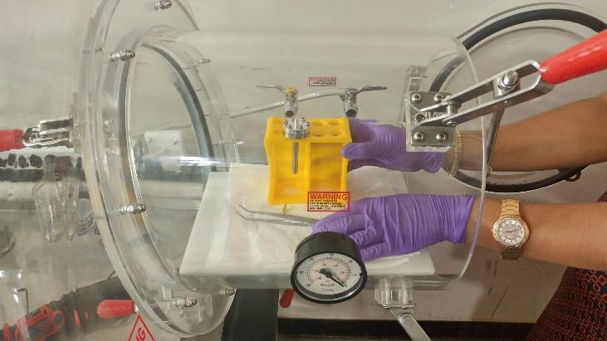
4. Open the exchange portal and place equipment and sample inside.

Slide 20
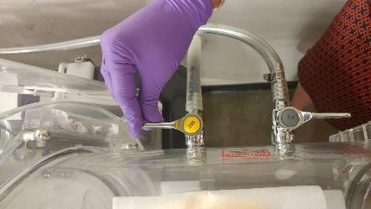
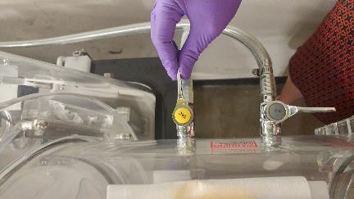
5. Evacuate the exchange portal by opening the vacuum valve. Wait until the gauge reads about -28 in Hg before closing the valve
Open
Closed

Slide 21
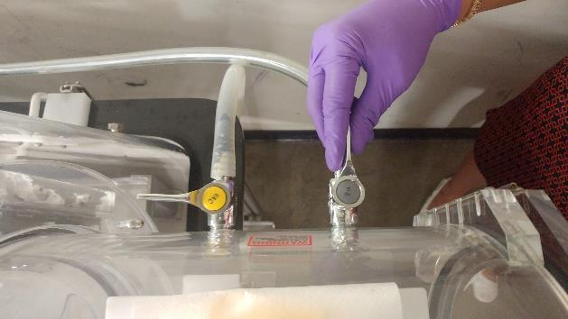
6. Flush the exchange portal with helium gas by opening the He valve. Wait until the pressure gauge reads zero.
Note: The valve says N₂ on it, but it is actually Helium!
7. Evacuate and flush the exchange portal once more.

Slide 22
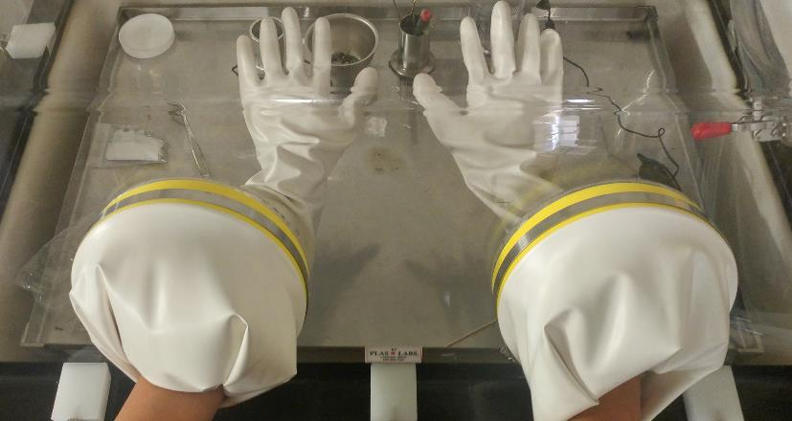
8. Insert hands into white gloves attached to the glovebox.

Slide 23
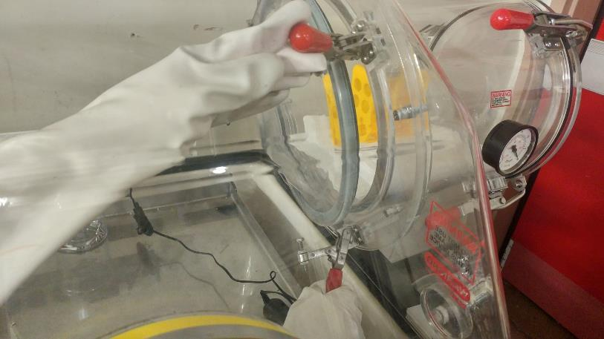
9. Open exchange portal inner gate and take the sample out. Close the gate afterwards.

Slide 24
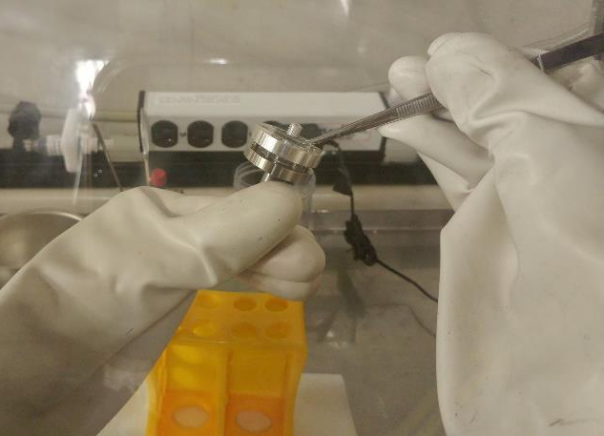
10. Once the sample is in, lift the lid for a few seconds to flush the interior with helium.

Slide 25
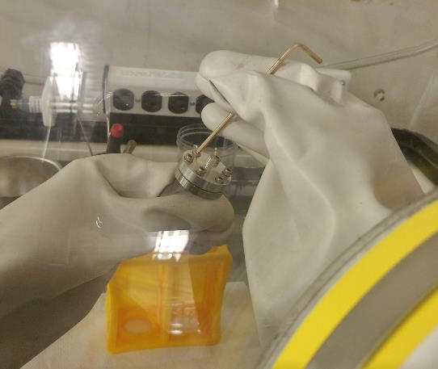
11. Tighten the screws using an Allen wrench in a way that evenly presses the indium into the gasket. Tighten them symmetrically (what you do to one side, do to the other) and tighten them hand-tight.

Slide 26

12. Check that the gap between the cap and flange is even all around.
Tighten the corresponding screws to even up the air gap. If this fails, the indium gasket is most likely uneven and has to be redone (STEP 3).
13. Place sample and tools back in the exchange port.
14. Secure the inner portal gate before taking the sample out of the glovebox.

Slide 27
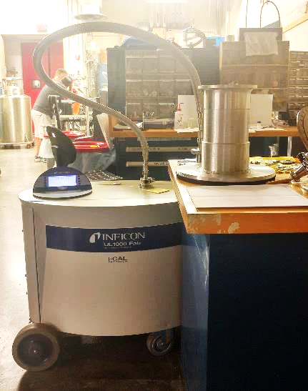
[ LEAK CHECKING A SAMPLE CAN ]
Helium Leak Checker

Slide 28
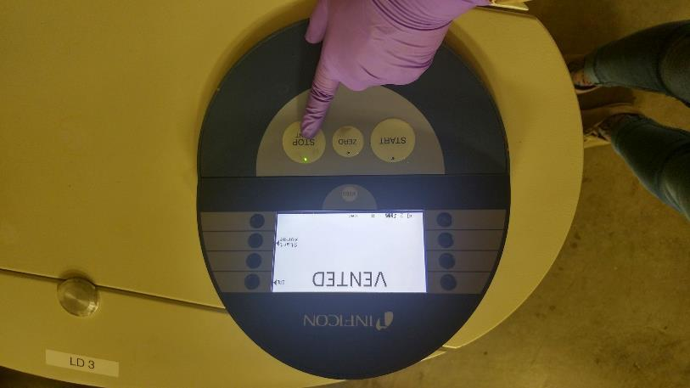
1. Press “Stop/Vent” to vent then open the leak checker sample well.

Slide 29
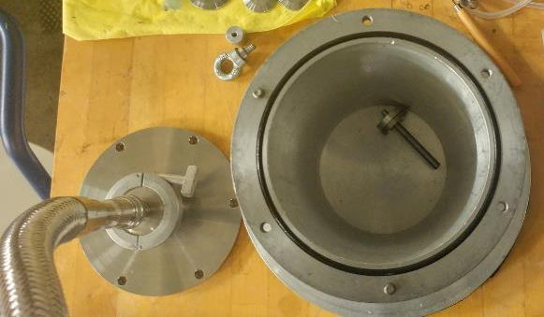
2. Place sample in sample well.

Slide 30
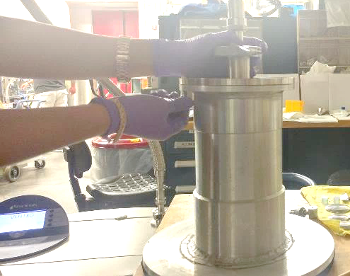
3. Secure the top of the leak checker to the sample well using the screws.

Slide 31
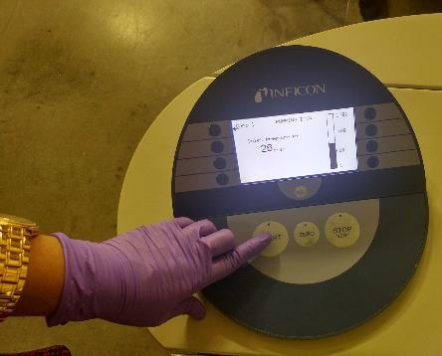
4. Press “Start” to begin evacuation of the sample well and wait for about 5 minutes.
For typical low temperature measurements, a leak rate of less than 10⁻⁴ mbar/s is acceptable.
For ³He and Dilution experiments, the leak rate needs to be less than 10⁻⁷ mbar/s
5. Press Stop for a few seconds to open the sample well.

Slide 32

6. Clean and place all equipment used in proper places
WARNING: Do not leave residual samples on the cryolab table. Please properly dispose off all samples and sample containers.
WARNING: Ensure that an ITEM’s label is attached to your sample can when you take it with you.
Please return any flammables you used (acetone, alcohol etc.) to the flammables cabinet.

